Slide 1
Advanced CPT (Java)
240-321, Semester 2, 2004-2005
11. Graphics
(Chapter 11, D&D)
Objective
  look at color, fonts, and how to draw shapes into applet/application windows;
  introduce the JPanel painting style

Slide 2
Contents
1. WelcomeApplet.java Again
2. Painting in More Detail
3. ModernHW.java
4. Colours
5. Fonts
continued

Slide 3
6. Lines, Rectangles, Ovals
7. Arcs
8. Polygons and Polylines
9. Graphics in More Detail
10. Java 2D
11. Java 3D

Slide 4
1. WelcomeApplet.java Again
import javax.swing.JApplet;
import java.awt.Graphics;
public class WelcomeApplet extends JApplet
{
public void paint(Graphics g)
{
g.drawString(“Welcome Andrew”, 25,25);
}
}
Use paint() to draw
into an applet.

Slide 5
WelcomeApplet.html
<html>
<head>
<title>Welcome Andrew</title>
</head>
<body>
<hr>
<applet code=“WelcomeApplet.class”
width=300 height=30>
</applet>
<hr>
</body>
</html>

Slide 6
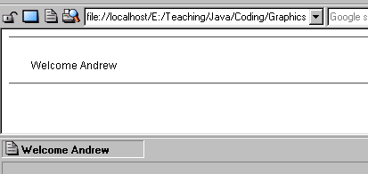
WelcomeApplet in Action

Slide 7
1.1. Drawing Strings and Chars
void drawString(String string, int x,int y);
  draws a string in the current font & colour at (x,y)
void drawChars(char chars[],
int offset, int number,
int x, int y);
  offset is the char array index position;
  number is the no. of characters to draw

Slide 8
(x,y) is the lower-left corner of the text, so drawing at (0,0) will mean the text is invisible
  it will appear off the top of the screen
(0,0)
Hello

Slide 9
Examples
String s = “hello”;
char c[] = {‘a’, ‘n’, ‘d’, ‘y’};
// draw string at (100,25)
g.drawString(s, 100, 25); // “hello”
// draw c[1]-c[3] at (100,50)
g.drawChars(c, 1, 3, 100, 50); // “ndy”

Slide 10
2. Painting In More Detail
Painting concepts:
  the Graphics context
  how paint() works
  the coordinate system
  drawing methods
  the drawbacks with paint()
  paintComponent()
  what is a “drawing panel”?

Slide 11
2.1. The Graphics Context
g.drawString()
  g is the graphics object representing the look of the applet on screen: called the graphics context for the applet/application
applet
drawing
area
:
g.drawString(...);
:
g
applet code
browser

Slide 12
A graphics object contains methods and data related to drawing:
  e.g. the drawing area, current font, color
Graphics objects are instances of the Graphics class.
continued

Slide 13
Good news: The programmer does not have to directly obtain the graphics object for the applet/application window
  the runtime system (the JVM) supplies it as an argument to paint()

Slide 14
2.2. How paint() Works
public void paint(Graphics g);
  draws the graphics context stored in g which represents the entire applet/application window
  called by the runtime system at certain times
  the programmer does not call paint() directly from code
continued

Slide 15
paint() is called automatically at the start to draw the window, and whenever the window needs to be redisplayed
  e.g when the window was hidden and is uncovered
The programmer must override paint() to specify what will be drawn.
continued

Slide 16
The programmer can request a repaint by calling repaint()
  this asks the JVM to call paint()
A programmer should not call paint() directly from code.

Slide 17
2.3. The Coordinate System
Graphical methods use an (X,Y) coordinate system to place things in a window:
0
+x
0
X axis
(X,Y)
note
+y
Y axis

Slide 18
2.4. Drawing Methods
The names of the methods for drawing text, lines, shapes, etc. are very similar:
  void drawXXX(...);
  void fillXXX(...);
  replace “XXX” by String, Line, Rect, RoundRect, 3DRect, Arc, Polygon, … to get the names of the methods
    examples later
continued

Slide 19
drawXXX() puts an outline of the shape on the screen.
fillXXX() fills the interior with a solid colour.

Slide 20
2.5. Drawbacks of paint()
The paint() method is designed to write the graphics context for the entire applet or application.
That is okay when the applet/application does not have a complicated interface with GUI controls, different drawing areas (drawing panels), etc.
continued

Slide 21
What a programmer usually wants is to specify the painting behaviour for a given component of the graphics context
  e.g. redraw the contents of a pop-down list,
  redraw the image inside a panel
Redrawing a single component is done by the JVM calling the component’s paintComponent()method.

Slide 22
2.6. paintComponent()
public void paintComponent(Graphics g);
  this method must be overriden by a programmer for a given component
When the top-level paint() method is called by the JVM, it automatically requests that all of its components be repainted by calling their paintComponent() methods.
continued

Slide 23
The modern coding approach is not to override paint()
Instead the programmer overrides paintComponent() for the components of the applet/application.

Slide 24
2.7. What is a “drawing panel”?
The most common use of paintComponent() is to redraw a “drawing panel” which is a component of a more complicated applet/application.
In JDK 1.2 and later, a drawing panel is implemented by subclassing JPanel.

Slide 25
3. ModernHW.java
This application shows:
  the use of paintComponent() in a JPanel
  how to use a JPanel inside a JFrame
  the use of GUI components in JFrame
This application displays “Hello World” again, but in a separate panel from the rest of the GUI.

Slide 26
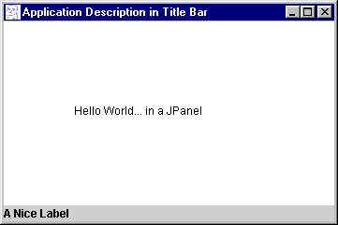
ModernHW in Action
This window appears in the
center of the computer screen.

Slide 27
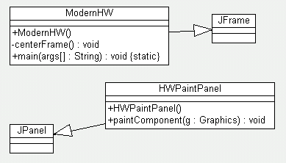
UML Class Diagram

Slide 28
ModernHW.java Code
import javax.swing.*;
import java.awt.*;
public class ModernHW extends JFrame
{
public ModernHW()
{
super("Application Description in Title Bar");
Container c = getContentPane();
c.setLayout( new BorderLayout() );
:

Slide 29
// A paint panel above a label
HWPaintPanel pp = new HWPaintPanel();
c.add( pp, "Center");
JLabel lab = new JLabel( "A Nice Label" );
// not necessary
c.add( lab, "South" ); // not necessary
setDefaultCloseOperation(JFrame.EXIT_ON_CLOSE);
// setSize(300,200);
centerFrame(); // position the frame
show();
} // end of ModernHW()

Slide 30
private void centerFrame()
/* Place the frame in the center of the
screen, and make it quarter size.
Add a icon in the top-left of the frame.*/
{
Toolkit tk = Toolkit.getDefaultToolkit();
Dimension d = tk.getScreenSize();
int screenHeight = d.height;
int screenWidth = d.width;
setSize(screenWidth/2, screenHeight/2);
setLocation(screenWidth/4, screenHeight/4);
Image img = tk.getImage("sface.gif");
setIconImage(img);
} // end of centerFrame()
public static void main( String args[] )
{ new ModernHW(); }
} // end of ModernHW class

Slide 31
class HWPaintPanel extends JPanel
/* A panel used as a 'paint' canvas.
This class will be made more complex later.
This same class can be used in applets also.*/
{
public HWPaintPanel()
{ setBackground(Color.white);
// other initialisation stuff goes here
}
public void paintComponent(Graphics g)
{ super.paintComponent(g);
// repaint standard stuff first
// painting operations go here....
g.drawString("Hello World... in a JPanel",
75, 100);
}
} // end of HWPaintPanel

Slide 32
3.1. ModernHWApplet
This applet displays the same “Hello World” string as the ModernHW application.
The painting component (the JPanel subclass) is unchanged from the code in ModernHW.java.
  this simplifies the portability issue of changing between an applet and application

Slide 33
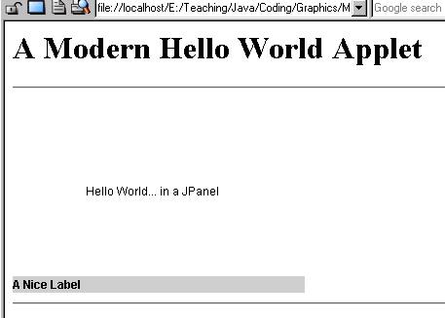
ModernHWApplet in Action

Slide 34
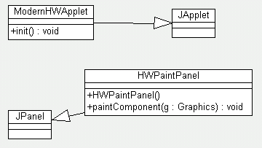
UML Class Diagram

Slide 35
ModernHWApplet.java
import javax.swing.*;
import java.awt.*;
public class ModernHWApplet extends JApplet
{
public void init()
{
Container c = getContentPane();
c.setLayout( new BorderLayout() );
HWPaintPanel pp = new HWPaintPanel();
c.add( pp, "Center");
JLabel lab = new JLabel( "A Nice Label" );
c.add( lab, "South" );
} // end of init()
} // end of ModernHWApplet class

Slide 36
The same class as in the application.
class HWPaintPanel extends JPanel
/* A panel used as a 'paint' canvas.
This class will be made more complex later.
This same class can be used in applications.*/
{
public HWPaintPanel()
{ setBackground(Color.white);
// other initialisation stuff goes here
}
public void paintComponent(Graphics g)
{ super.paintComponent(g);
// painting operations go here....
g.drawString("Hello World... in a JPanel",
75, 100);
}
} // end of HWPaintPanel

Slide 37
ModernHWApplet.java
<html>
<head><title>A Modern Hello World Applet</title></head>
<body>
<h1>A Modern Hello World Applet</h1>
<hr>
<applet code="ModernHWApplet.class"
width="300" height="200">
</applet>
<hr>
</body>
</html>

Slide 38
4. Colours
A colour is defined using an RGB (Red/Green/Blue) triplet of values:
  3 integers, each in the range 0 to 255
  (or 3 floats, each in the range 0.0f to 1.0f)
  as a number gets bigger, so the amount of colour increases
0 = black (off)
1 = full on

Slide 39
4.1. Predefined Colours
Colour Constants RGB triple
Color.orange 255,200,0
Color.pink 255,175,175
Color.black 0,0,0
Color.white 255,255,255
Color.red 255,0,0
Color.green 0,255,0
Color.blue 0,0,255
:
Other standard colours:
  cyan, darkGray, gray, lightGray, magenta, yellow
  see D&D fig. 11.3, p.518 for more
note

Slide 40
4.2. Colour Methods
public Color(int r, int g, int b);
public Color(float r, float g, float b);
  creates a Color object based on the RGB values
  e.g. Color c = new Color(0,0,0);
Set the colour of the next graphical thing to be drawn (the foreground colour):
  g.setColor(c);
continued

Slide 41
Return a Color object containing the current foreground colour:
  c = g.getColor();
int getRed();
int getBlue();
int getGreen();
  returns the colour value as an int
  e.g. int redAmount = c.getRed();
continued

Slide 42
An existing colour can be made brighter or darker:
  c.brighter();
  c.darker();
To make a colour very bright:
  c.brighter().brighter().brighter();

Slide 43
4.3. ShowColors.java
Illustrates painting with colours.
Uses the same JFrame and JPanel structure as ModernHW.java.

Slide 44
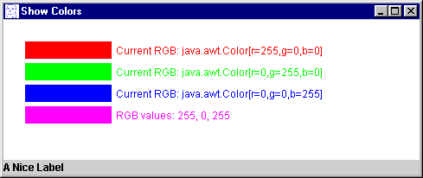
ShowColors in Action
This window appears in the
center of the computer screen.

Slide 45
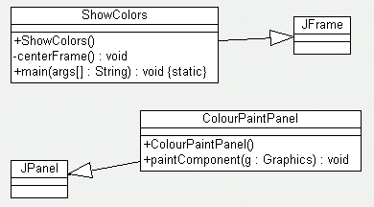
UML Class Diagram

Slide 46
ShowColors.java Code
import javax.swing.*;
import java.awt.*;
public class ShowColors extends JFrame
{
public ShowColors()
{
super( "Show Colors" );
Container c = getContentPane();
c.setLayout( new BorderLayout() );
:

Slide 47
Apart from the new paint
panel, the rest of the JFrame
is unchanged.
ColourPaintPanel pp = new ColourPaintPanel();
c.add( pp, "Center");
JLabel lab = new JLabel( "A Nice Label" );
c.add( lab, "South" );
setDefaultCloseOperation(
JFrame.EXIT_ON_CLOSE);
// setSize(300,200);
centerFrame();
show();
} // end of ShowColors()

Slide 48
private void centerFrame()
{...} // as in ModernHW class
public static void main( String args[] )
{ new ShowColors(); }
} // end of ShowColors class

Slide 49
class ColourPaintPanel extends JPanel
/* A panel used as a 'paint' canvas.
Illustrates some Colour methods.
*/
{
public ColourPaintPanel()
{
setBackground(Color.white);
// other initialisation stuff goes here
}

Slide 50
public void paintComponent(Graphics g)
{
super.paintComponent(g);
// painting operations go here...
// set new drawing color using integers
g.setColor( new Color(255, 0, 0) ); // red
g.fillRect( 25, 25, 100, 20 );
g.drawString( "Current RGB: " +
g.getColor(), 130, 40 );
// set new color (green) using floats
g.setColor( new Color(0.0f, 1.0f, 0.0f) );
g.fillRect( 25, 50, 100, 20 );
g.drawString( "Current RGB: " +
g.getColor(), 130, 65 );
:

Slide 51
// set color using static Color objects
g.setColor( Color.blue );
g.fillRect( 25, 75, 100, 20 );
g.drawString( "Current RGB: " +
g.getColor(), 130, 90 );
// display individual RGB values
Color c = Color.magenta;
g.setColor( c );
g.fillRect( 25, 100, 100, 20 );
g.drawString( "RGB values: " + c.getRed() +
", " + c.getGreen() + ", " +
c.getBlue(), 130, 115 );
}
} // end of ColourPaintPanel

Slide 52
4.4. JColorChooser
JColorChooser is a SWING GUI for interactively selecting colours
  intended for applications where the user needs to select colours

Slide 53
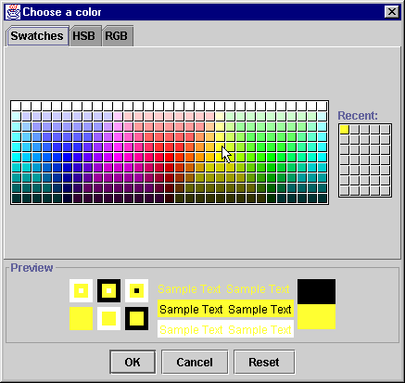
For more info,
look in D&D,
sections 11.6,
11.7

Slide 54
5. Fonts
A Font object is defined using three attributes:
  its name (e.g. “Serif”)
  its style (e.g. ITALIC)
  its point size (e.g. 24)
continued

Slide 55
Creating a Font object:
  Font loud = new Font(“Serif”,
  Font.BOLD, 18);
Set the graphic object’s font:
  g.setFont(loud);
  drawn text will use this font until it is changed with another call to setFont()
continued

Slide 56
Times New
Roman
Courier
New
Arial
Five logical font names can be assumed:
  Serif, Monospaced, SansSerif, Dialog, DialogInput
Font style constants in the Font class:
  Font.PLAIN, Font.BOLD, Font.ITALIC
  they can be combined (see example)
continued

Slide 57
String[] getAvailableFontFamilyNames()
  returns a list of the available fonts on your machine
The drawback of using fonts other than the standard logical fonts is that your code may not be portable.

Slide 58
5.1. Fonts.java
Illustrates the painting of text with various fonts.
Uses the same JFrame and JPanel structure as previously.

Slide 59
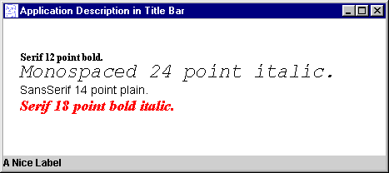
Fonts.java in Action

Slide 60
Fonts.java Code
import javax.swing.*;
import java.awt.*;
public class Fonts extends JFrame
{
public Fonts()
{
super( ”Fonts Example" );
Container c = getContentPane();
c.setLayout( new BorderLayout() );
:

Slide 61
FontsPaintPanel pp = new FontsPaintPanel();
c.add( pp, "Center");
JLabel lab = new JLabel( "A Nice Label" );
c.add( lab, "South" );
setDefaultCloseOperation(
JFrame.EXIT_ON_CLOSE);
// setSize(300,200);
centerFrame();
show();
} // end of Fonts()

Slide 62
private void centerFrame()
{ ... } // same as in ModernHW
public static void main( String args[] )
{ new Fonts(); }
} // end of Fonts class

Slide 63
class FontsPaintPanel extends JPanel
/* A panel used as a 'paint' canvas.
Illustrates font manipulation. */
{
public FontsPaintPanel()
{
setBackground(Color.white);
// other initialisation stuff goes here
}

Slide 64
public void paintComponent(Graphics g)
{
super.paintComponent(g);
// painting operations go here....
// set font to Serif (Times), bold, 12pt
// and draw a string
g.setFont( new Font("Serif", Font.BOLD, 12) );
g.drawString("Serif 12 point bold.", 20, 50);
// set current font to Monospaced (Courier),
// italic, 24pt and draw a string
g.setFont( new Font("Monospaced",
Font.ITALIC, 24) );
g.drawString( "Monospaced 24 point italic.",
20, 70 );
:

Slide 65
// set current font to SansSerif (Arial),
// plain, 14pt and draw a string
g.setFont( new Font("SansSerif",Font.PLAIN,14));
g.drawString("SansSerif 14 point plain.",20,90);
// set current font to Serif (times),
// bold/italic, 18pt and draw a string
g.setColor( Color.red );
g.setFont(
new Font("Serif",Font.BOLD+Font.ITALIC, 18));
g.drawString( g.getFont().getName() + " " +
g.getFont().getSize() +
" point bold italic.", 20, 110 );
}
} // end of FontsPaintPanel

Slide 66
5.2. Font Metrics
Information available for a font:
..
leading
(inter-line gap)
max
ascent
Xy1A
height
ascent
descent
max
descent

Slide 67
Accessing Font Metric Info
Obtaining FontMetric information from a window is done in two steps:
  get the FontMetrics object for the window
  access the FontMetrics object
FontMetrics fm = g.getFontMetrics();
continued

Slide 68
There are a range of methods for extracting details from a FontMetrics object
e.g
  int getAscent();
  int getDescent();
  int getLeading();
  int getHeight();
  int h = fm.getHeight();

Slide 69
Why Bother?
FontMetrics information is used in applications where the exact position of text blocks must be known.
  e.g. centre text in the middle of a window
What is
the (x,y)
coordinate
so the text
is centered?
height
hello everyone
h
y = height/2 - h/2
see slide 26

Slide 70
6. Lines, Rectangles, Ovals
6.1. Lines
void drawline( int x1, int y1,
int x2, int y2);
  draw a line between (x1,y1) and (x2,y2) in the current foreground colour
(x1,y1)
(x2,y2)

Slide 71
6.2. Rectangles
(x,y)
width
height
void drawRect(int x, int y,
int width, int height);
  draw a rectangle of the specified width and height. Its top-left corner is at (x,y).
void fillRect(int x, int y,
int width, int height);
  draw a solid rectangle. Use the current foreground colour.
continued

Slide 72
rectangle
window
void clearRect(int x, int y,
int width, int height);
  Use the current background colour (i.e. the colour of the window).
  Frequently used to ‘erase’ something by covering it with the background colour

Slide 73
6.3. Rounded Rectangles
A rectangle with rounded corners:
(x, y)
arc height
requires
six parameters
arc width
height
width
continued

Slide 74
void drawRoundRect(
int x, int y,
int width, int height,
int arcWidth, int arcHeight);
void fillRoundRect(
int x, int y,
int width, int height,
int arcWidth, int arcHeight);

Slide 75
6.4. 3D Rectangles
These are ordinary rectangles with shading along two edges, to make them look three dimensional.
Two types: raised and lowered
requires 5 parameters:
(x,y), width, height,
and whether raised
continued

Slide 76
void draw3DRect(
int x, int y,
int width, int height,
Boolean raised);
  The rectangle is raised if raised is true; otherwise lowered.
void fill3DRect(
int x, int y,
int width, int height,
Boolean raised);

Slide 77
6.5. Ovals
Dimensions of an oval:
(x, y)
four
parameters
height
width
continued

Slide 78
void drawOval(
int x, int y,
int width, int height);
void fillOval(
int x, int y,
int width, int height);

Slide 79
LinesRectsOvals.java
Illustrates the drawing of various kinds of lines, rectangles, and ovals.
Uses the same JFrame and JPanel structure as previously.

Slide 80
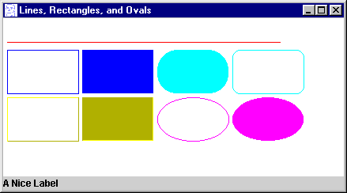
LinesRectsOvals.java in Action

Slide 81
LinesRectsOvals.java
import javax.swing.*;
import java.awt.*;
public class LinesRectsOvals extends JFrame
{
public LinesRectsOvals()
{
super( ”Lines, Rectangles, and Ovals" );
Container c = getContentPane();
c.setLayout( new BorderLayout() );
:

Slide 82
// A paint panel above a label
LROPaintPanel pp = new LROPaintPanel();
c.add( pp, "Center");
JLabel lab = new JLabel( "A Nice Label" );
c.add( lab, "South" );
setDefaultCloseOperation(
JFrame.EXIT_ON_CLOSE);
// setSize(300,200);
centerFrame();
show();
} // end of LinesRectsOvals()

Slide 83
private void centerFrame()
{ ... } // same as in ModernHW
public static void main( String args[] )
{ new LinesRectsOvals(); }
} // end of LinesRectsOvals class

Slide 84
class LROPaintPanel extends JPanel
/* A panel used as a 'paint' canvas.
Illustrates the drawing of lines,
rectangles, and ovals. */
{
public LROPaintPanel()
{
setBackground(Color.white);
// other initialisation stuff goes here
}

Slide 85
public void paintComponent(Graphics g)
{
super.paintComponent(g);
// painting operations go here....
g.setColor( Color.red );
g.drawLine( 5, 30, 350, 30 );
g.setColor( Color.blue );
g.drawRect( 5, 40, 90, 55 );
g.fillRect( 100, 40, 90, 55 );
g.setColor( Color.cyan );
g.fillRoundRect( 195, 40, 90, 55, 50, 50 );
g.drawRoundRect( 290, 40, 90, 55, 20, 20 );
:

Slide 86
g.setColor( Color.yellow );
g.draw3DRect( 5, 100, 90, 55, true );
g.fill3DRect( 100, 100, 90, 55, false );
g.setColor( Color.magenta );
g.drawOval( 195, 100, 90, 55 );
g.fillOval( 290, 100, 90, 55 );
}
} // end of LROPaintPanel

Slide 87
7. Arcs
An arc is a portion of an oval.
An arc is drawn between two angles:
  a starting angle and and an arc (ending) angle
(x,y)
90
0 degrees
height
180
ending
angle
starting angle
width
270
continued

Slide 88
positive sweep
negative sweep
A positive sweep measures the angle in the “counter-clockwise” direction
  the angle is a positive value (e.g. 275)
A negative sweep measures the angle in the “clockwise’ direction
  the angle is a negative value (e.g. -85)
continued

Slide 89
a positive number means “positive
sweep”; negative means “negative
sweep”
void drawArc(
int x, int y,
int width, int height,
int startAngle, int arcAngle);
void fillArc(
int x, int y,
int width, int height,
int startAngle, int arcAngle);

Slide 90
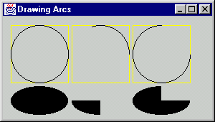
Examples

Slide 91
8. Polygons and Polylines
Polygons are multi-sided shapes, represented by a series of (x,y) points.
Polylines are a series of points connected by straight lines.
continued

Slide 92
Polygons are closed shapes.
Polylines may be open or closed
  an open polyline does not end where it began
  e.g. the example on the previous slide
Only polygons can be filled with colour
  since they are closed

Slide 93
Polygon Methods
public Polygon(int xs[], int ys[],
int num);
  returns a new Polygon object with num sides; x coordinates from xs[],
  y coordinates from ys[]
  e.g.
  int xs = {20,30,20};
  int ys = {20,30,40};
  Polygon p = new Polygon(xs,ys,3);
continued

Slide 94
(20,20)
(30,30)
(20,40)
void drawPolygon(Polygon p);
  draw the polygon p in the graphics object
  e.g. g.drawPolygon(p);
void fillPolygon(Polygon p);
  draw the filled polygon; use the current colour
  e.g. g.fillPolygon(p);

Slide 95
Polyline Method
void drawPolyLine(
int xs[], int ys[], int num);
  draw the polyline specified by the coordinates in xs[] and ys[]; num is the number of points
  if the last point is different from the first then the polyline is open
continued

Slide 96
(20,20)
(30,30)
(20,40)
e.g.
int xs = {20,30,20};
int ys = {20,30,40};
g.drawPolyline(xs,ys,3);

Slide 97
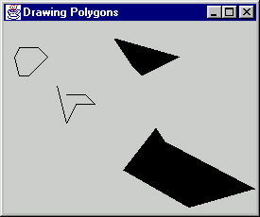
Examples

Slide 98
9. Graphics in More Detail
A good overview, using the same coding style (JFrame, JPanel) as here:
  Core Java 1.2, Vol. 1 -- Fundamentals
  Horstmann & Cornell
  Sun Microsystems Press, 1999
  Chapter 7, “Graphics Programming”

Slide 99
10. Java 2D
Java 2D was introduced in JDK 1.2. to deal with weaknesses in the basic graphics classes:
  e.g. single-pixel thickness lines, limited fonts, poor shape manipulation (e.g. no rotation), no special fills/gradients/patterns inside shapes, poor image support

Slide 100
10.1. Features of Java2D
Shapes
  arbitrary geometric shapes can be represented by combining lines and curves
Stroking
  lines and shape outlines can be drawn using any pattern and thickness
Filling
  shapes can be filled with colour, patterns, colour gradients, images
continued

Slide 101
Transformations
  all shapes, text, images can be stretched, contracted, and rotated by changing the coordinate system
Alpha Composition
  composition is the dynamic adding of new elements to an existing drawing
  transparency becomes possible
Clipping
  clipping is the limiting of drawing operations to some drawing boundary
continued

Slide 102
Antialiasing
  reduces jagged edges in drawings
Text
  any TrueType or Type 1 font can be used
    Windows, Postscript
Image Processing
  clipping, transformation, alpha composition, JPEG supported
Printing

Slide 103
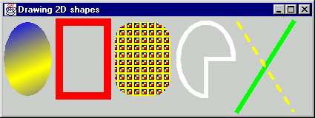
10.2. Examples
gradient
filling
strokes
patterned
filling
new
shapes
strokes
continued

Slide 104
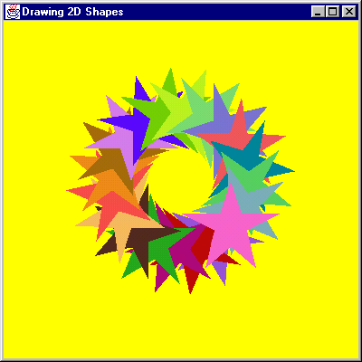
new shapes;
transforms;
antialiasing

Slide 105
10.3 Drawing in Java 2D
public void paintComponent(Graphics g)
{
super.paintComponent(g);
Graphics2D g2d = (Graphics2D)g;
// cast the graphics object
// set pen parameters
// create a shape
// draw the shape (filled or outline)
}

Slide 106
Pen Parameters
g2d.setPaint( fillColorOrPattern );
g2d.setStroke( penThicknessOrPattern );
g2d.setComposite( someAlphaComposite );
g2d.setFont( someFont );
g2d.translate(...);
g2d.rotate(...);
g2d.scale(...);
g2d.shear(...);
g2d.setTransform( someAffineTransform );

Slide 107
Create a Shape
Rectangle2D.Double rect = ...;
Ellipse2D.Double ellipse = ...;
Polygon poly = ...;
GeneralPath path = ...;
SomeShapeYouDefined shape = ...;
// must implement the Shape interface
There is a Shape class for most of the drawXXX() methods in the old Graphics class.

Slide 108
Built-in Shape Classes
Several classes
have similar
versions in AWT
Arc2D.Double, Arc2D.Float
Area
  a shape built by adding/subtracting other shapes
CubicCurve2D.Double, CubicCurve2D.Float
Ellipse2D.Double, Ellipse2D.Float
GeneralPath
  a series of connected shapes
Line2D.Double, Line2D.Float
Polygon
QuadCurve2D.Double, QuadCurve2D.Float
Rectangle2D.Double, Rectangle2D.Float, Rectangle
RoundRectangle2D.Double, RoundRectangle2D.Float
Most classes have
double and float
versions to vary
the precision.

Slide 109
Draw a Shape
Draw an outlined or filled version of the shape:
  g2d.draw( someShape );
  g2d.fill( someShape );
The old methods are still supported:
  drawString() still used
  drawLine(), drawRect(), fillRect() fairly common

Slide 110
Drawing Shapes Example (part)
In DrawShape2D.java
class DrawShape2DPanel extends JPanel
{
private Ellipse2D.Double circle =
new Ellipse2D.Double(10, 10, 300, 300);
private Rectangle2D.Double square =
new Rectangle2D.Double(10, 10, 300, 300);
public void paintComponent(Graphics g)
{
super.paintComponent(g);
Graphics2D g2d = (Graphics2D)g;
g2d.fill(circle);
g2d.draw(square);
}
}

Slide 111
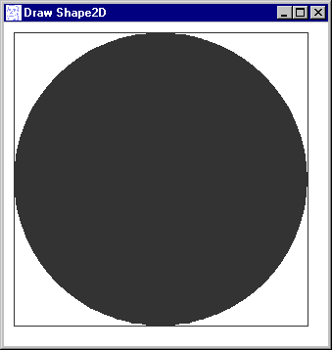
Output

Slide 112
10.4 Painting in Java 2D
Use setPaint() and getPaint() to change and retrieve the Paint settings
  setPaint() and getPaint() replace the
  setColor() and getColor() methods used in Graphics
continued

Slide 113
When you fill a shape, the current Paint attribute of the Graphics2D object is used.
Possible argumnts to setPaint():
  a Color (a solid color)
  a GradientPaint
    a gradient fill gradually combining two colours
  a TexturePaint (a tiled image)
  a new version of Paint that you've written

Slide 114
Gradient Fill Example
class GradientPaintPanel extends JPanel
{ // red at (0,0), yellow at (175,175)
private Ellipse2D.Double circle = ...;
private GradientPaint gradient =
new GradientPaint(0, 0, Color.red,
175, 175, Color.yellow,
true); // true means repeat pattern
public void paintComponent(Graphics g)
{ super.paintComponent(g);
Graphics2D g2d = (Graphics2D)g;
g2d.setPaint( gradient );
g2d.fill( circle );
g2d.setPaint( Color.black );
g2d.draw( circle );
}
}

Slide 115
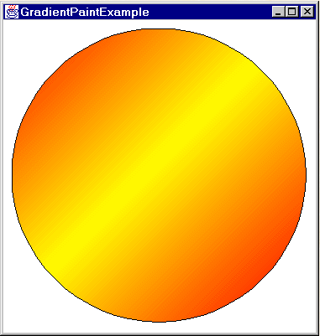
Output

Slide 116
10.5 Coordinate Transforms
Instead of calculating new coordinates for the shape, change the coordinate system
  i.e. change the x- and y- axes
Available transforms:
  translate (move the axes)
  rotate
  scale (resize the axes)
  shear (stretch the axes more when further from origin
  matrix manipulation

Slide 117
Translation/Rotation Example
private Color[] colors =
{ Color.white, Color.black };
public void paintComponent(Graphics g)
{ super.paintComponent(g);
Graphics2D g2d = (Graphics2D)g;
drawGradientCircle(g2d); // my method
drawThickCircleOutline(g2d); // my method
// Move origin to center of circle
g2d.translate(185.0, 185.0);
for (int i=0; i < 16; i++) {
// Rotate coordinate system around current
// origin, which is at center of circle
g2d.rotate( Math.PI/8.0 );
g2d.setPaint(colors[i%2]); // white <-> black
g2d.drawString("Java", 0, 0);
}
}

Slide 118
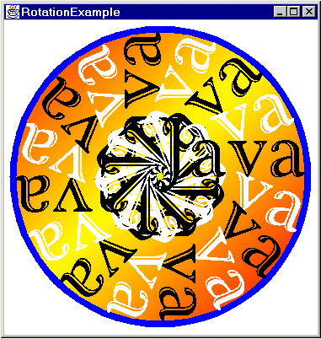
Output

Slide 119
10.6. More Java 2D Information
Java: How to Program
Deitel and Deitel
Prentice Hall
Java 2D Graphics
Jonathan Knudsen
O’Reilley, 1999
I have a copy
continued

Slide 120
Java2D: An Introduction and Tutorial
  by Marty Hall
  http://www.apl.jhu.edu/~hall/java/
  Java2D-Tutorial.html
  a quick introduction to the basics of Java2D
  my examples come from this Website

Slide 121
11. Java 3D
Java 3D is a collection of high-level classes for creating and manipulating 3D geometry in a 3D scene graph.
There are methods for creating 3D shapes, visualizations (e.g. lighting), animations, and interaction (e.g. touch, collisions).
continued

Slide 122
Implemented using JNI so Java 3D can utilise OpenGL or DirectX
  allows Java 3D to run on a very wide range of platforms
Used in the Roboforge game.
Details at:
  http://java.sun.com/products/
  java-media/3D/

Slide 123
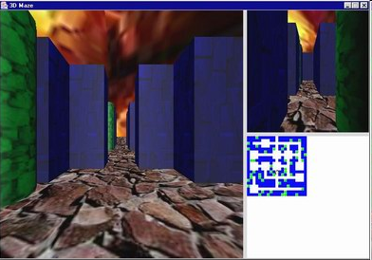
I am writing a book about Java games programming. The Java 3D chapters:
  http://fivedots.coe.psu.ac.th/~ad/jg/

